Slide 1
MatterIn Insights that matter

Slide 2



Level of insights
City Level
Area Level
Customer Lever

Slide 3




Fields in Each Level
Warehouse
Route
Product
Users

Slide 4


Types of insights
Descriptive Analytics
Predictive Analytics

Slide 5
Insights gained using data science & analytics
Entity Categorization
Pod Placement
Personalized Recommendations
Demand Forecasting
Quantile based
Optimization of cost and priority in constrained environment
Collaborative Filtering
Supervised Machine Learning Models

Slide 6
“Smartly Placing just 3 pods in a city with 15 society clusters (areas), can reduce the logistic distance by half. Area based demand forecasting can help stock the pods in advance. Personalized Recommendations can help boost sales ”

Slide 7
BIG CONCEPT
Data Science and Analytics can help accelerate the growth of MilkBasket

Slide 8
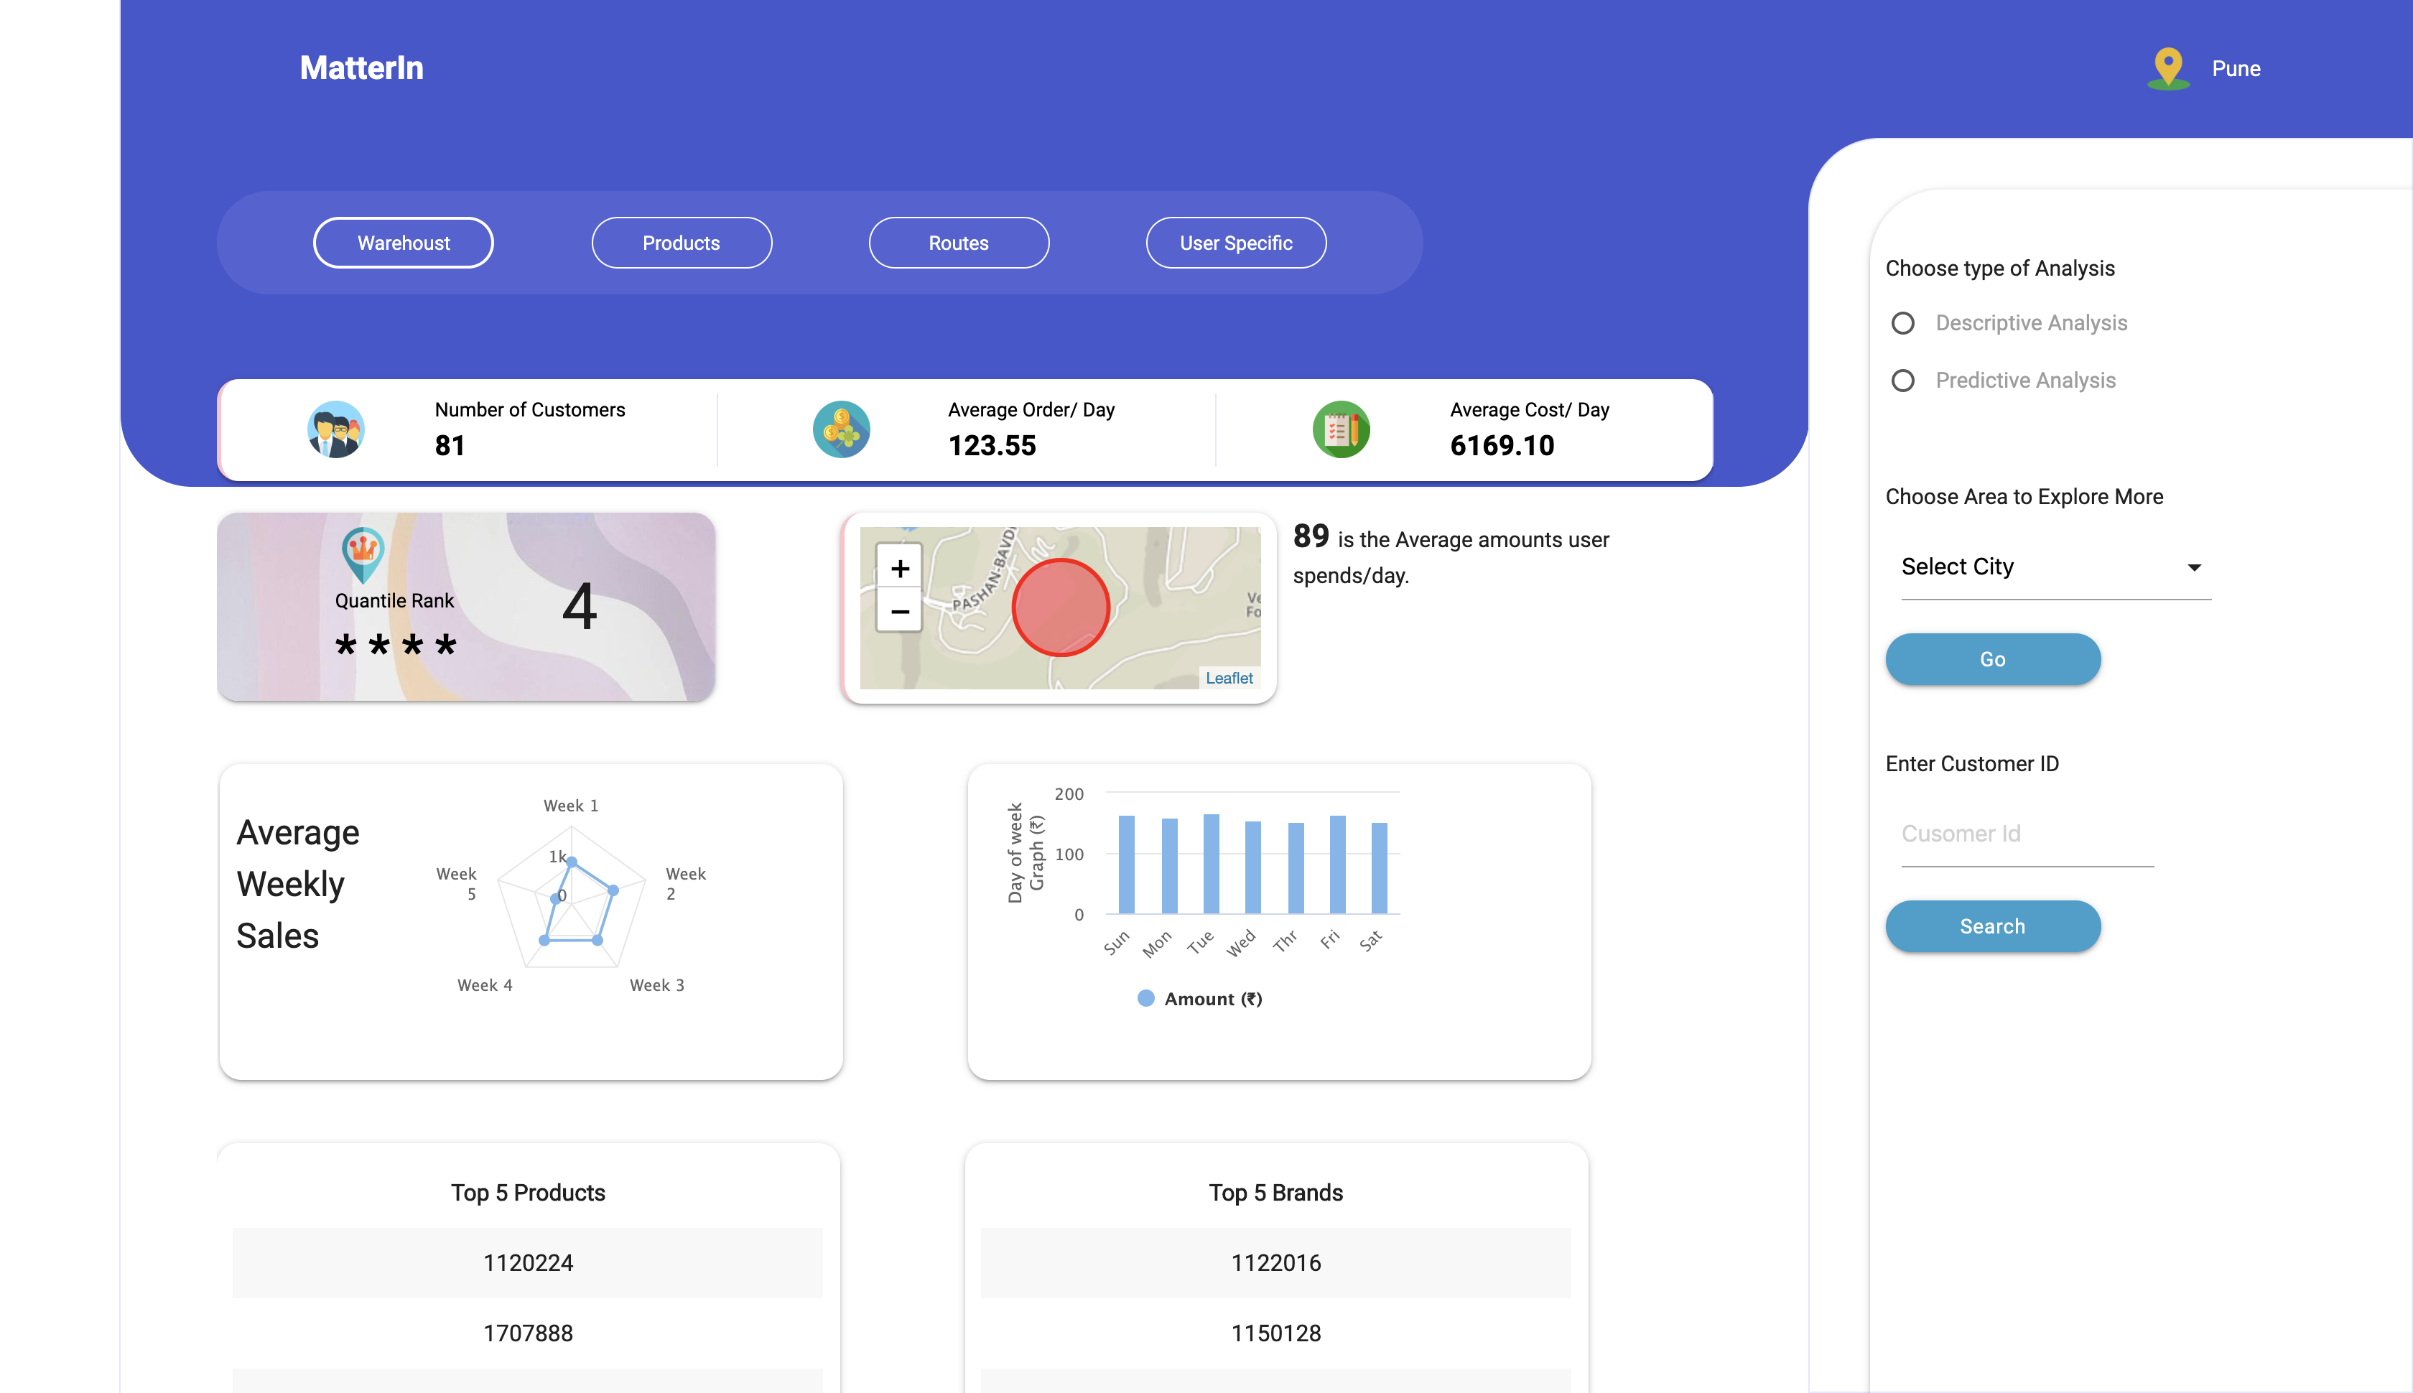
Web Dashboard
Place your screenshot here
Easy to view Dashboard to view insights and predictions and make important business decisions

Slide 9
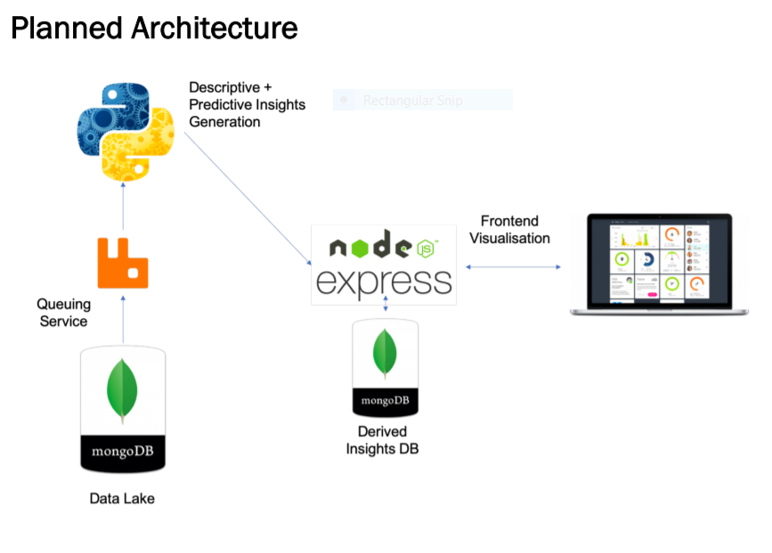

Slide 10

THANKS!

